Slide 1
Models
CIS662, Sep. 27, 2023

Slide 2
What do we mean by “Models”?
A real-life process (or system) generates data.
A model is any abstraction of process or system behavior or characteristics.
Models are expected to retain those aspects of the process that are important for the problems to be addressed.
As with any abstraction, some aspects of the process are not retained in the model.
The same process could be represented by many kinds of models.
Machine Learning is often viewed as the task of finding values for model parameters.

Slide 3
What we do in ML?
Most of the time, we begin with a specific class of models (e.g., feedforward neural networks with one hidden layer).
Each model has some ”parameters” (e.g., connection weights in the neural network).
Parameter values are often randomly initialized.
We use a “learning algorithm” to modify parameter values iteratively until: (a) results are satisfactory; or (b) results stop changing; or (c) computational resources are exceeded.

Slide 4
ML as a high-level meta-algorithm
Choose a class of models, based on past experience;
Initialize parameter values of one or more models;
While (results are unsatisfactory) and/or (results continue to change/improve over some number of iterations) and/or (number of iterations are not excessive), do:
Use the available data to modify model parameter values;
4. Interpret the resulting models (with updated parameter values).

Slide 5
Can we answer questions without using models?
Rote: We can memorize all the data available to us, and look through it whenever a question needs to be answered, for some kinds of problems.
“k-Nearest Neighbor” approaches attempt something like this: look through the data, find the k that are nearest to the new data for which an answer is needed, and rely on their consensus.
Such approaches can be inefficient, not applicable to some problems, and affected by noisy data; we cannot claim to have understood the data generation process.

Slide 6
Why do we need models?
Computational efficiency: it takes much less effort to work with models than with raw data.
Understanding: by focusing on the important aspects of the data, we can better understand and explain the process.
Noise insensitivity: reasoning with models avoids unnecessary and confusing aspects of data, as well as occasional errors.
Result quality: better results are obtained by working with models than with raw data.

Slide 7
Data vs. Information
“Information” usually refers to the important aspects of data, necessary to answer any questions.
Example:
”Data” about chairs may include millions of pictures—we don’t (and can’t) store all these pictures in our heads or on computers, since it requires enormous memory, and enormous time to retrieve data or answer questions about chairs.
Instead, we store a notion of what chairs are like.
As soon as I say “chair”, perhaps one image comes to mind.
If I ask whether something is a chair, you can quickly answer the question based on what you understand as the essential aspects of a chair.

Slide 8
Compression
Information is obtained by compressing data to enable answering certain kinds of questions about data (old or new).
How is this information to be stored?
MODELS!
“Good Models” enable efficient data compression, as well as efficient and accurate query-answering.

Slide 9
Model selection criteria: Usefulness
Adequacy and expressive power: what it is capable of representing
Suitability for a task: ability to represent problem-specific knowledge
Quality of solutions obtained (e.g., bias & variance)

Slide 10
Model selection criteria: Size
Number of trainable parameters
Magnitudes of parameters
Complexity of components of the model
Number of bits needed to describe the model

Slide 11
Model selection criteria: computational effort
How to find the right settings for hyper-parameter values;
Data preprocessing effort
Any additional effort required to interpret model outputs
Can we build a hardware implementation?

Slide 12
Model selection criteria: robustness
System behavior when:
a part of the model “fails”;
the input data is noisy;
the data generation process or the environment changes with time;
unfamiliar kinds of data are presented;
adversaries attack (to steal information, to modify model parameters, or to fake its outputs)

Slide 13
Need to choose models and learning algorithms
The same problem may be addressed using diﬀerent models!
E.g., a decision tree or a neural network may be used for a classification problem.
The same model’s parameter values can be estimated using diﬀerent learning algorithms.
E.g., backpropagation or evolutionary strategies may be used for training a neural network’s weights.

Slide 14
On model complexity
Occam’s razor: prefer simpler models, with fewer parameters
Avoid over-fitting
Expected to perform better on test data
But: what if the more complex model gives better quality results, and obtains them faster?
We must consider the tradeoff!

Slide 15
Strategies for finding the right size model
Start small, and grow (iteratively).
Start big, and prune (iteratively).
Regularize: add a size penalty term to the loss function (or other quantity being optimized).

Slide 16
Models frequently used in ML
Data points themselves; prototypes; boundary samples
Sets of equations (linear, polynomial, differential, …)
Logical formulas (e.g., if-then rules)
Relations
Graphs (e.g., social networks)
Neural networks
Decision Trees (and their collections)
Markov Models
[Each of these uses different learning algorithms, to be discussed later.]

Slide 17
1. Data points (as models)
The model is to be represented as a set of points in the data space.
Answers to new problems are provided by k-nearest neighbors approach using this model (not the original data).
Special cases:
Centrally located data: a subset of all data available to us, each representing a collection of points in the data.
Cluster centroids: similar to (a), but need not be data points.
Generalized cases: similar to (b), with non-numeric data.
Boundary samples: data points that are very similar (near) to others for which the answers are different.

Slide 18
Properties
The amount of “compression” obtained depends on the ratio of the size of the original dataset to the size of the subset of points stored in the model.
This approach is useful when large amounts of compression are obtained.

Slide 19
Examples
Clustering: cluster centroids or medoids may represent all the data to which they are nearest.
Case-based reasoning: generalizations of actual data are represented, often in a hierarchy that represents inheritance as well as exceptions.

Slide 20
2. Equations (as models)
The model is to be represented as a set of equations that relate variables to be predicted and variables whose values are known. Answers for new data are provided by mathematical calculations.
Post-processing needed if final desired outputs are not numeric.
Special cases:
Linear equations
Polynomials
Less simple equations (e.g., logistic functions, Fourier transforms)
Differential equations (of different orders)

Slide 21
Properties
Coefficients in the equations are the parameters to be learnt by ML algorithms.
The number of coefficients, as well as the complexity of the equations, determines the expressive power, bias-variance tradeoff points, as well as computational effort needed for learning.
Experts’ problem-specific domain knowledge may be incorporated into the overall form of the equations.

Slide 22
Examples
Polynomial regression models
Kernel regression models (e.g., “Support Vector Machines”)
Statistical time series models (ARMA, ARIMA, …)
Fourier or wavelet transforms of audio signals

Slide 23
Example time series model from https://www.machinelearningplus.com/time-series/arima-model-time-series-forecasting-python/
An ARIMA model is one where the time series was differenced at least once to make it stationary and you combine the AR and the MA terms. So the equation becomes:
Predicted Yt = Constant + Linear combination Lags of Y (upto p lags) + Linear Combination of Lagged forecast errors (upto q lags)

Slide 24
3. Logical Formulas & Rules
The model is to be represented as a set of logical formulas that relate variables to be predicted (or acted upon) and variables whose values are known.
Answers for new data are provided by logical reasoning, including forward/backward chaining
Special cases:
Association rules
Horn logic formulas
Production rules

Slide 25
Properties
Knowledge can be expressed using small modules (individual rules) which are independently justifiable.
Learning may be very difficult if there are no constraints on the complexity of the logical formula (used in the left hand side of a rule).

Slide 26
Examples
Data mining
Expert Systems
Case-based learning of adaptation rules
Learning Classifier Systems
Logic programs

Slide 27
Example of Horn Clauses, from M. Hauskrecht, U. Pitt.
I1. If the animal has hair then it is a mammal
I2. If the animal gives milk then it is a mammal
I3. If the animal has feathers then it is a bird
I4. If the animal flies and it lays eggs then it is a bird
I5. If the animal is a mammal and it eats meat then it is a carnivore
I6. If the animal is a mammal and it has pointed teeth and it has claws and its eyes point forward
then it is a carnivore
I7. If the animal is a mammal and it has hoofs then it is an ungulate
18. If the animal is a mammal and it chews cud then it is an ungulate and it is even-toed
I9. If the animal is a carnivore and it has a tawny color and it has dark spots then it is a cheetah
I10. If the animal is a carnivore and it has a tawny color and it has black strips then it is a tiger
I11. If the animal is an ungulate and it has long legs and it has a long neck and it has a tawny color
and it has dark spots then it is a giraffe
I12. If the animal is an ungulate and it has a white color and it has black stripes then it is a zebra
Il3. If the animal is a bird and it does not fly and it has long legs and it has a long neck and it is black
and white then it is an ostrich,
Il4. If the animal is a bird and it does not fly and it swims and it is black and white then it is a
penguin
Il5. If the animal is a bird and it is a good flyer then it is an albatross.

Slide 28
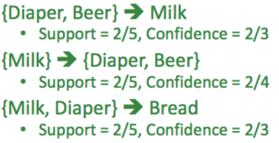
Example of association rules used in data mining, from https://towardsdatascience.com/association-rule-mining-be4122fc1793
Support: P(A&B), Confidence:P(B|A)

Slide 29

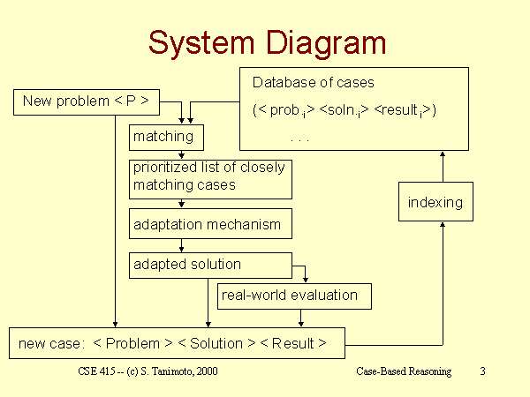
Case Based Reasoning System
From https://courses.cs.washington.edu/courses/cse415/00sp/lecture-slides/Case-based-reasoning/sld003.htm

Slide 30
4. Relations (Tables)
The model is to be represented as n-ary relations (tables).
Answers for new data are provided by performing relational operations on the tables.
Special case:
Tables with a distinguished “column” representing what is to be predicted (a value, category, or action).

Slide 31
Properties
Attribute selection may be performed first, so that we ignore irrelevant data.
Discretization of numeric values may lead to a small number of categories, shrinking the tables.
A few small tables (with few columns) may be used as the model, instead of a large table with millions of data points—each table may be thought of as a feature.

Slide 32
Examples
Data mining
Q-tables used in reinforcement learning, indicating the expected quality of outcomes if a particular action is taken when we are in one state.

Slide 33
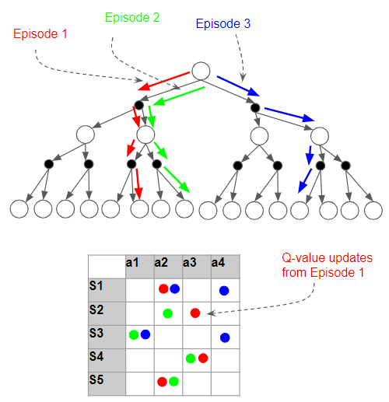
Example of Q-table used in reinforcement learning
(Image by author)
From https://towardsdatascience.com/reinforcement-learning-explained-visually-part-4-q-learning-step-by-step-b65efb731d3e

Slide 34
5. Graphs (Networks) = Binary Relations
The model is to be represented as a set of network containing nodes and edges, all of which are labeled.
Answers for new data are provided by performing operations on the graph.
Special cases:
Nodes may be labeled or unlabeled
Edges may carry numeric or non-numeric labels
Edges may be directed or undirected
Multiple edges may connect two nodes, carrying different kinds of labels

Slide 35
Properties
Easy to visualize—if the graphs are small.
Graph search algorithms can be used, as appropriate.
In many applications, it is important to learn sparse graphs.

Slide 36
Examples
Game trees (e.g., chess-playing)
Probabilistic inference networks, representing
Causality
Belief updating
Social networks (nodes denote human agents), representing:
Collaboration
Communication
Pre-existing relations
Infection
Influence

Slide 37
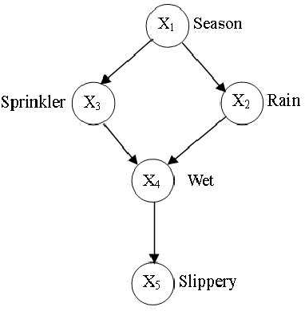
Example showing dependence relations in a probabilistic inference network, from https://www.catalyzex.com/paper/arxiv:1011.0935 (by J. Ding)

Slide 38
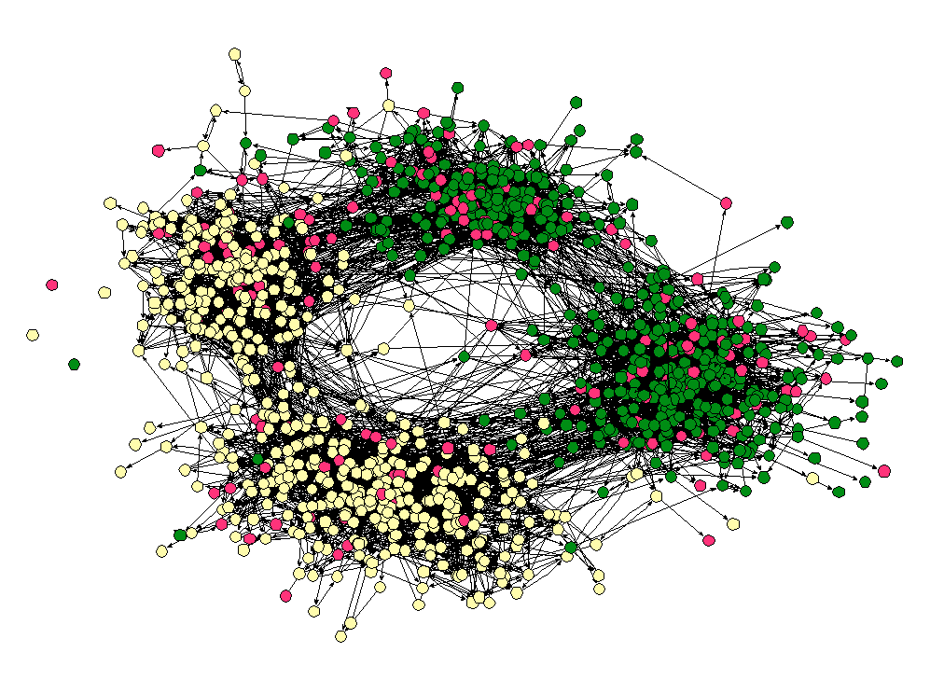
Example social network in a high school, from Ch. 4 of http://www.cs.cornell.edu/home/kleinber/networks-book/

Slide 39
6. Neural Networks
The model is to be represented as a directed graph whose nodes represent simple computations to be performed, and weighted edges indicate how the outputs of a node are modified for the computations of another node.
Answers for new data are provided by performing node computations, usually in a prespecified sequence of layers.
Special Cases:
NNs with cycles
Layered NNs
Shallow vs. Deep NNs

Slide 40
Examples
Perceptrons
Convolutional NNs
Associative memories
Topologically self-organizing maps
Prediction networks with recurrent modules
Transformer

Slide 41
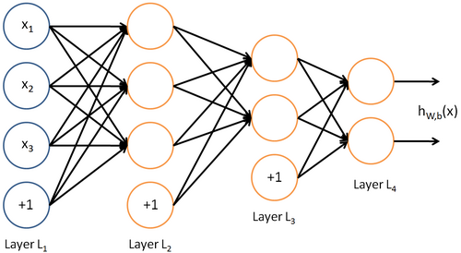
Example of a (shallow feedforward) neural network, from https://towardsdatascience.com/first-neural-network-for-beginners-explained-with-code-4cfd37e06eaf

Slide 42
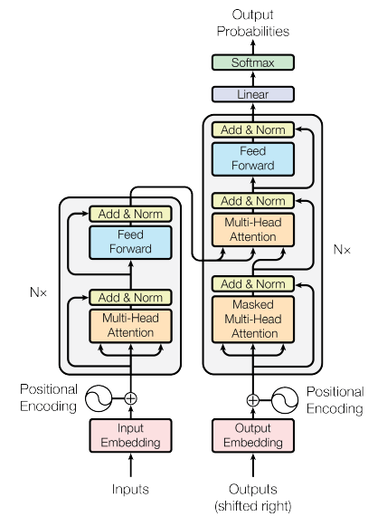
“Transformer” neural network model example, from https://www.baeldung.com/cs/chatgpt-model

Slide 43
Properties
Several variations of neural networks exist; we must select the right model for a given problem.
Learning may be expensive depending on the size of the model.
Models may permit a very large number of local optima of the performance measure (e.g., MSE).
Bias-variance tradeoff: avoid over-training, and use large models only if needed (and if enough data is available).
Convergence of an ML algorithm (= reaching a point from which there is no further change) does not imply that the best solution has been found!

Slide 44
7. Decision Trees (and Forests)
The model is to be represented as one or more trees.
Each internal node represents a question, whose answers correspond to one of the branches below it.
Each leaf node represents the set of data obtained by the path of answers from the root to that leaf, and is associated with an answer (obtained by summarizing training data leading to that leaf).
Answers for new data are provided by asking the questions beginning from the root, and finding the appropriate leaf.

Slide 45
7… Decision Trees (and Forests)
Variations:
Simple decision trees with yes/no questions on individual attributes
Oblique trees whose nodes use linear combinations of attributes
Neural trees whose nodes perform nonlinear computations
Non-binary trees in which nodes can have multiple children depending on the values of attributes
Ensembles

Slide 46

Properties
Easy to understand and explain to non-ML users.
Tree depth may increase without bound.
Question asked at a node may be simple or complex.
We can estimate uncertainty associated with a leaf node, based on training data.
Variations use entropy, information gain,

Slide 47
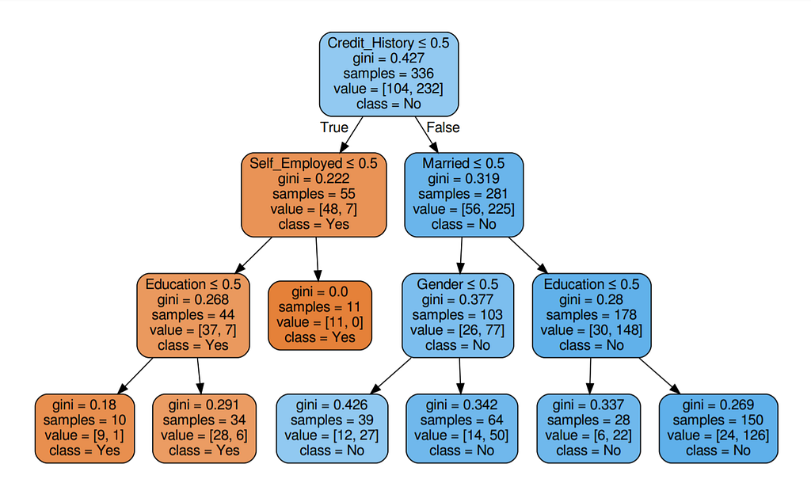
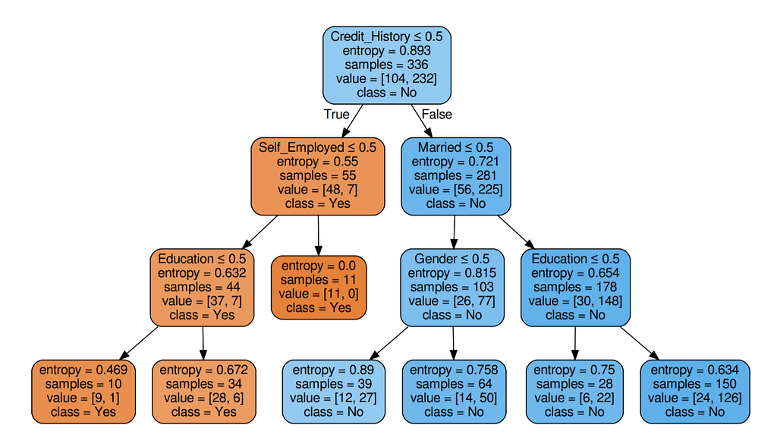
Example from https://towardsai.net/p/programming/decision-trees-explained-with-a-practical-example-fe47872d3b53

Slide 48
Examples
Classification trees
Regression trees
Random forests
Genetic Programming

Slide 49
8. Markov Models
The model is to be represented as a state machine, in which:
some states may be “hidden” (not directly observed), and
transitions from state to state occur with some probability (labeling the transition), depending on inputs from the environment.
Answers for new data are provided by simulating execution of the model over time.

Slide 50
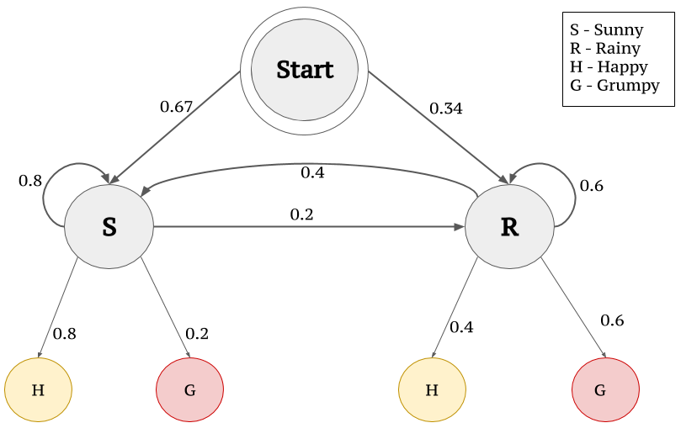
Markov Model Example from https://towardsdatascience.com/markov-and-hidden-markov-model-3eec42298d75

Slide 51
Criteria for Model Selection
Adequacy and expressive power (what the model is capable of representing)
Number of trainable parameters
Information complexity: number of bits needed to describe the model
Procedure for finding the right settings for hyper-parameter values

Slide 52
…[More] Criteria for Model Selection
Robustness: what happens if a part of the model “fails”, or the input data is noisy, or the environment changes
Quality of solutions obtained
Computational eﬀort required to obtain solutions
Ability to represent problem-specific knowledge
Ability to build a hardware implementation.

Slide 53
How do we know which model to use and when?
The key word: experience!
Sometimes, the nature of the problem dictates the model.
Image processing: convolutional neural networks
Causal reasoning: probabilistic inference networks
Language processing: transformers
The amount of available data limits the maximum model complexity.
If data arrives over time, and the data generation process changes with time, then some static models are ruled out.
For new classification problems, you may have to try several different models before learning what’s best.
Ensemble models (possibly heterogeneous) have lately been shown to provide the best results.

